Slide 1
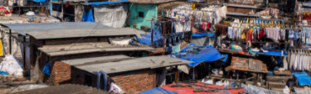
Poverty
By: Hafiz Moghul, Tulhaa Jamil, and Rijja Mughal
PYP Exhibition
2020-2021

Slide 2
Our topic
We chose poverty as our exhibition topic because it is one of the most important problems in our world
Poverty is a condition in which a person or community lacks the financial resources and essentials for a minimum standard of living. There are different ways to describe it such as absolute, extreme, and relative.
Around 1.89 billion people, or nearly 36% of the world's population, lives in extreme poverty, on less than $1.25 a day

Slide 3
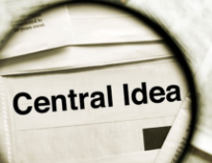
Central Idea
The inaccessibility to resources creates a harsh living condition and difficult life circumstances for those in poverty.
عََدَم ِإمكانية الْوُصُولِ إِلَى الْمَوَاردِ يُؤَدِّي
إِلَى خَلْقِ ظُرُوفٍ مَعِيشِيَّة ٍقَاسِيَّةٍ وَظُرُوفٍ حَياتيةٍ صَعْبَةٍ لِمَن يَعِيشُونَ فِيَ الفَقْر

Slide 4
Line of Inquiry
Lines of Inquiry:
1. Inaccessibility to clean water.
عَدَمُ إِمْكَانِيَّةِ الْوُصُولِ إِلَى مِياهٍ نَظِيفَة
2.How Interest and Debt creates poverty
كَيْفَ تُؤَدِّي الربا وَ الدُّيُونُ إِلَى الْفَقْر
3. Ways to provide resources for those in need
طُرُقٌ لِتَوْفِيرِ الْمَوَارِدِ لِلْمُحْتَاجِين

Slide 5
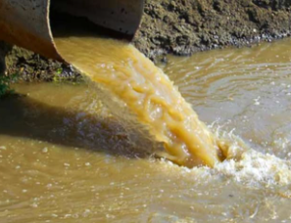
Why isn't there any clean water for me?
INACCESSIBILITY TO CLEAN WATER.
Access to water, sanitation, and hygiene are a basic human right
Limited to no access for some due to their ethnicity, gender, social status, disability or inability to afford the high costs.
Growing world population = strain on already scarce and fragile water source.
Poor sanitation causes diseases, loss of education, and death.
Notes:
INACCESSIBILITY TO CLEAN WATER.
Having access to water, sanitation, and hygiene are all basic things that all human's should have access to, but some people don’t have access due to their ethnicity, gender, social status, disability or they can not afford the high costs of clean water.
When the population of earth increases clean water will be more rare and fragile
Poor sanitation causes diseases, loss of education, and death.
Water is linked to poverty because is u are poor sometimes u may not have access to clean water due to high costs and people in poverty do not have that much money.

Slide 6
facts
Almost 4 million people die each year from water related diseases.
The average toilet uses 8 liters of clean water in a single flush.
At any one time, more than half the world’s poor are ill due to not enough sanitation, water or hygiene.
70% of earth's surface is water but polluted water is one of the largest problems in the world.
Contaminated drinking water is estimated to cause 485 000 diarrheal deaths each year.
Notes:
Facts
Almost 4 million people die each year from water related diseases.
The average toilet uses 8 liters of clean water in a single flush.
At any one time, more than half the world’s poor are ill due to not enough sanitation, water or hygiene.
70% of earth's surface is water but polluted water is one of the largest problems in the world.
Contaminated drinking water is estimated to cause 485 000 diarrhoeal deaths each year.

Slide 7
What The quran says about dirty water عَدَمُ إِمْكَانِيَّةِ الْوُصُولِ إِلَى مِياهٍ نَظِيفَة
Notes:
MANY PEOPLE IN THE WORLD DONT HAVE ACCESS TO CLEAN WATER AND IN THE QURAN IT MENTIONS:

Slide 8
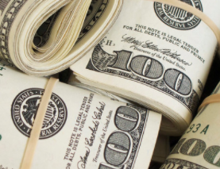
Don’t Apply Interest (LOI#2)
Most banks and most people who lend money use interest
A lot of people use interest because they don’t have enough
The lender does not share risk, but places it on the borrower.
A lot of people become poor or even poorer because of debt and interest.
Notes:
Most banks and most people who lend money use interest
A lot of people use interest because they don’t have enough
The lender does not share risk of losing anything, but places it on the borrower.
A lot of people become poor or even poorer because of debt and interest.

Slide 9
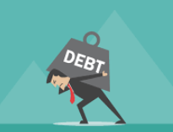
Debt and Interest
Debt is an amount of money that is borrowed and will be paid back usually with interest
A loan is when you borrow money and you pay back the same amount to the other person.
Interest is anything paid back above the loan amount.
Interest is haram.
How much interest you pay is calculated as the percentage of interest (APR)
Notes:
Debt is an amount of money that is borrowed and will be paid back usually with interest
A loan is when You borrow money and pay back the same amount back to the person
Interest is when you pay back more than you borrowed
Interest is haram because Interest benefits the loaner and does not benefit the borrower.
Rather than debt better to invest and share as partners.
Our religion encourages lending as a way of sadaqah because the lender may not profit. He shouldn't charge interest.

Slide 10
What Islam and the Quran Say About Interest and debt
كَيْفَ تُؤَدِّي الفَائِدَةُ والدُّيونُ إلى الفَقْر
Islamic Perspective
In Arabic interest is called Riba.
Riba is haram, It is a very bad sin.
Riba is used to make people poor and other people rich. It is a way to enslave people.
It is the only sin that Allah says is war against him and his prophet (surah Baqarah).
But equity includes by sharing risk and builds wealth for all.

Slide 11
QURAN (2:276-280)

Slide 12
It's Good To give
In 2006, a study was done where participants were given money and asked to think of a cause they may want to donate it. The results showed that just the act of thinking about giving activated the same pleasure-seeking parts of the brain as eating and exercise.

Slide 13
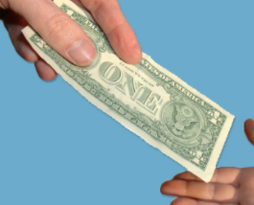
Every Little bit counts
We can help people by doing things like giving them money, find them a job, or give them food. Remember every little thing counts.
If everybody does a little bit then it will be a big change
Notes:
We can help people by doing things like giving them money, find them a job, or give them food.
Remember every little thing counts.
If everybody does a little bit then it will be a big change

Slide 14
What Islam says about giving
طُرُقٌ لِتَوْفِيرِ الْمَوَارِدِ لِلْمُحْتَاجِين
As Muslims we can do little things like just giving 1 dollar to someone or give them food, and that could help them a lot. This is something important in Islam. According to The Prophet PBUH: the three basic resources are, safety, health, and food.

Slide 15
Quran (107:1-7)

Slide 16
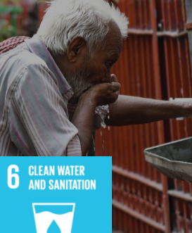
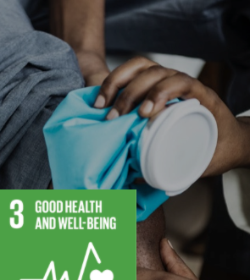
17 Un GOALS that relate
Notes:
We chose Gender Equality because some people due to gender inequality are not treated rightly and can not have access to clean water
We chose Clean water and sanitation because our second line of inquiry talks about clean water, sanitation, and dirty water.
Good health and well being because if u use interest you may become poor and if u become poor u may not be able to have access to clean water due to the high costs or gender inequality or ur social status. Then u may have to drink dirty water and may get a disease from it.

Slide 17
conclusion
Our research inspired us to give and to encourage giving.
Even giving little things to someone because remember every little thing counts.
We hope we have inspired everybody just as we have been inspired ourselves
A special thanks to Ms Ibrahim, Ms Salama, Ms Khan and Ms Ahmed for helping us
We would also like to share our action that we have taken about poverty.

Slide 18
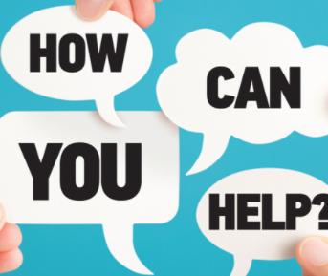
Our action and how you can help
There is an already going food pantry from MCC that we can donate dry food items to.
About MCC
LINK: https://mccmd.org/
Also in Penny Appeal you can buy dates from Palestine and 100% profit goes to Palestine
About Penny appeal
LINK: https://shop.pausa.org/
If you have any questions messaeg us at hmoghul@tarbiyahacademy.org
tjamil@tarbiyahacademy.org

Slide 19
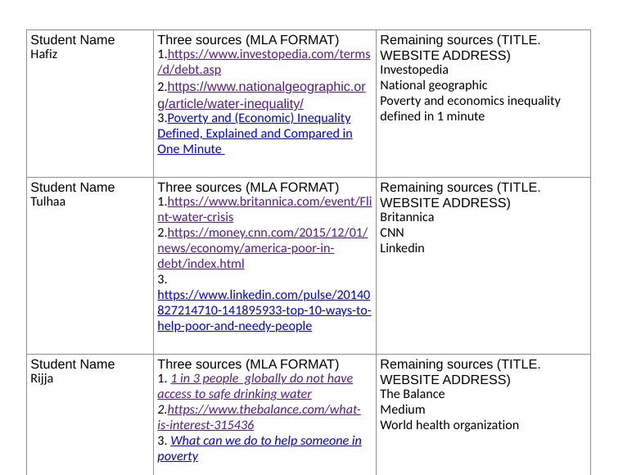
Citations

