Slide 1
HUMAN RIGHTS
Education, Social Class, and Segregation
By: Saira Ali, Zayaan Sharieff, and Zahra Yousuf
Notes:
Small note: First, we will give our greetings (the order for this is Zahra, Saira, and then Zayaan). Next, Saira will give a small summaries of the entire presentation. After that Zahra will start with the central idea and lines of inquiry in arabic and english. Explain we choose a book, because you shouldn’t judge a book by its cover.

Slide 2
Cental idea and
Lines of Inquiry
Central Idea and
Lines of Inquiry
تَتَطَلَّبُ الْمُسَاوَاةُ تَطْبِيقَ حُقُوقِ الْإِنْسَانِ وَالْعَدَالَة
تَتَطَلَّبُ الْمُسَاوَاةُ تَطْبِيقَ حُقُوقِ الْإِنْسَانِ وَالْعَدَالَة
Equality requires human rights and justice
Equality requires human rights and justice
حَاجَةُ كُلِّ إِنْسَانٍ إِلَى التَّعْلِيم
حَاجَةُ كُلِّ إِنْسَانٍ إِلَى التَّعْلِيم
LOI #1: The need for education for all human beings
LOI#1: The need for education for all human beings
تَأْثِيرُ الطَّبَقَةِ الاجْتِمَاعِيَّةِ عَلَى حَيَاةِ الْأَشْخَاص
LOI #2 : How social class can affect someone's life
LOI #2: How social class can affect someone's life
تَأْثِيرُ الطَّبَقَةِ الاجْتِمَاعِيَّةِ عَلَى حَيَاةِ الْأَشْخَاص
التَّمْيِّيزُ الْعُنْصُرِيّ
LOI #3 : Segregation
التَّمْيِّيزُ الْعُنْصُرِيّ
Notes:
Zahra

Slide 3
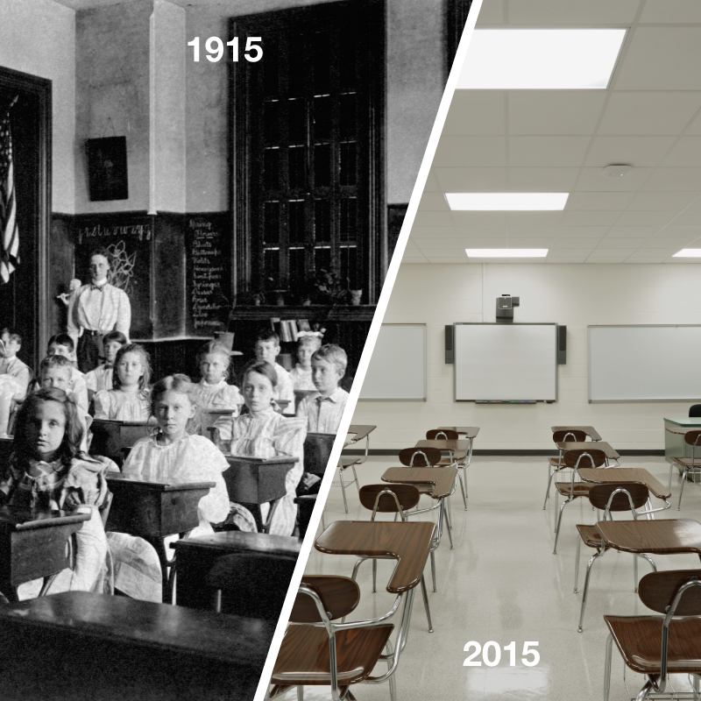
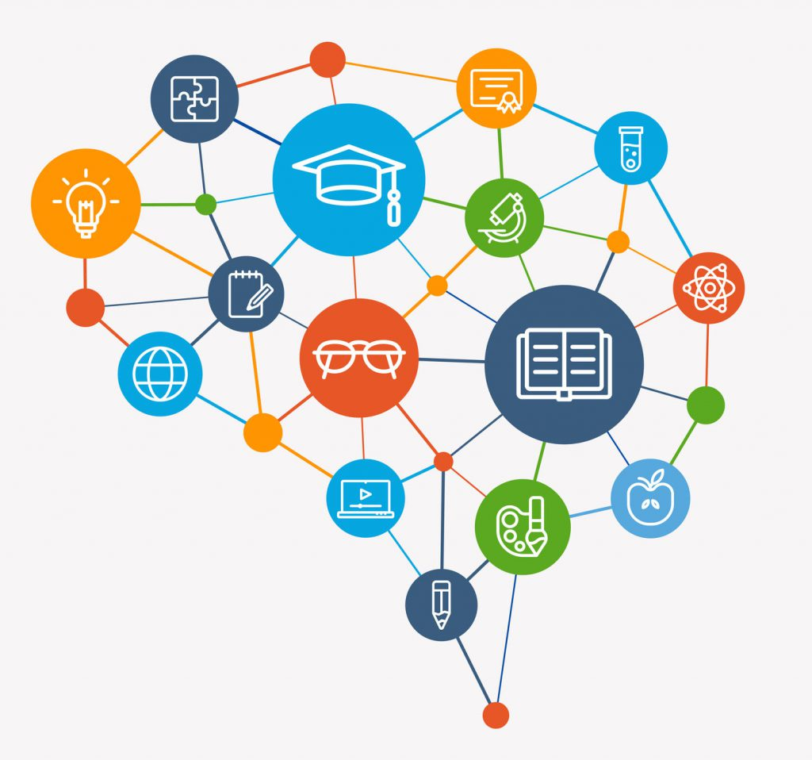
Education
Education in different times and places
Education is important in many ways
Notes:
Zayaan
Back then education had some bumps in it and it still does. Classroom sizes were bad, technology wasn't invented, students attitudes were not treated, and some parents were not involved with their kid's education. In this time, some countries can still have pretty bad education and that's not fair.
Now, you may be thinking is education important? Well, education can help reduce your chances of poverty. Education can have a big impact on your life, education also allows kids to develop social skills as well as basic needs in one's life. Education is NOT a right for ALL human beings, but should be. without it, problems will and are formed, which lasts for months and sometimes even years. The sad thing is 263 million people are denied the right to education and this can be because people get judged by their wealth or race.

Slide 4
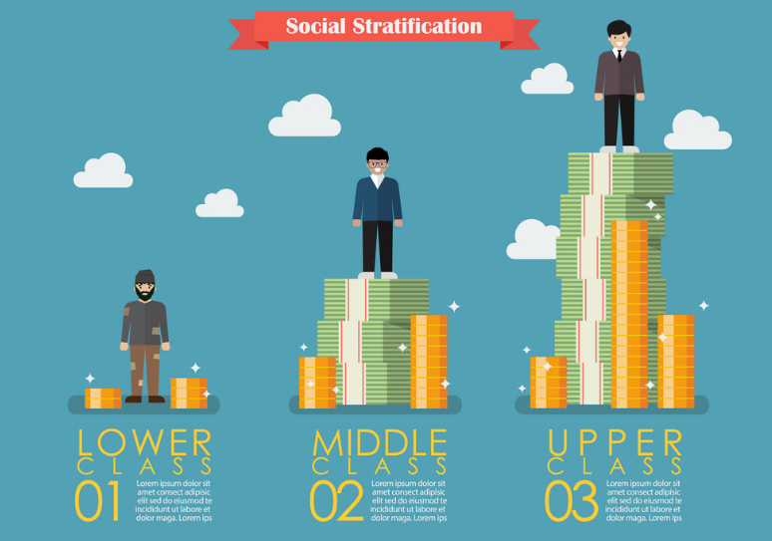
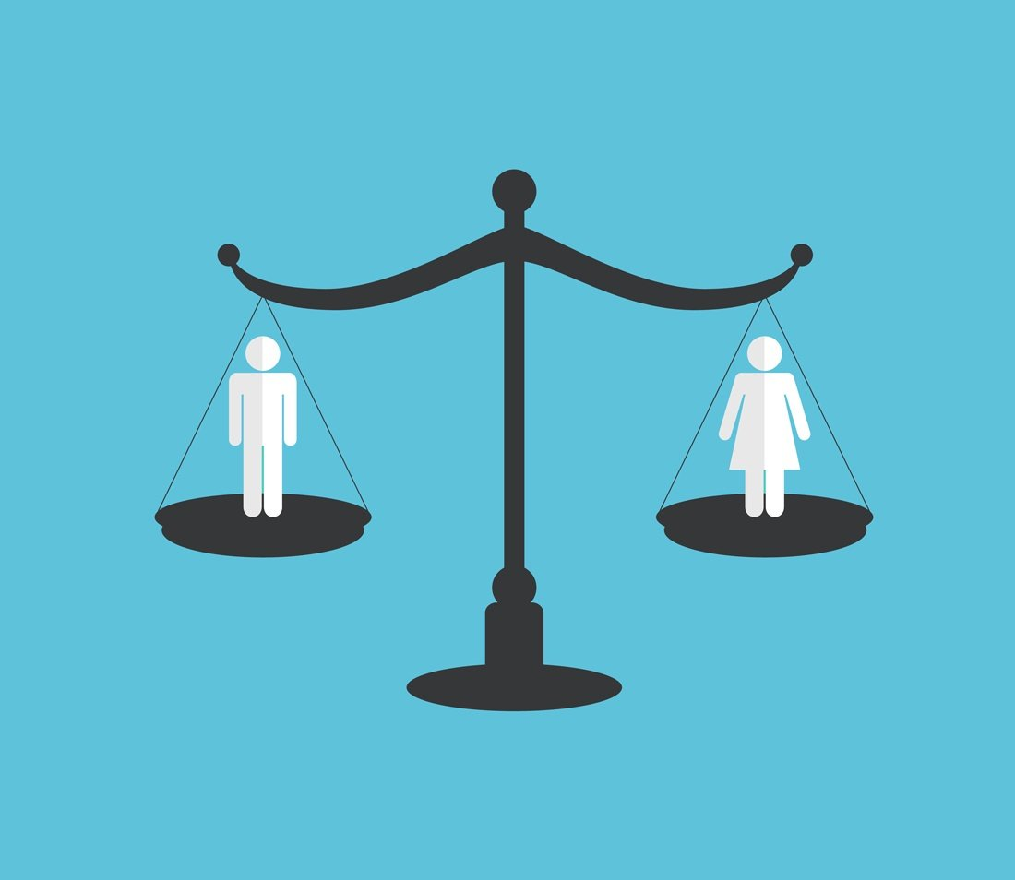
Social Class
The three main classes
The caste system
Changing your social class
Notes:
Saira
Social class has three main levels or status. The three main classes; the poor, the middle class and the rich, Some people, judge others by their looks or wealth, and sometimes when that happens people will start taking rights away from those people . Social class can be determined differently depending on the country or religion.
In India the caste system is a good example, the caste system divides Hindus into four categories based and their duty and has been around for 3,000 years. The caste has dictated every aspect of Hindus religious and social life. This is similar to social class because the upper classes and castes are always looking forward to protect their positions. While the lowers do the opposite. The caste system is not a good thing and can cause a lot of distinction between the society. At a young age you may not know what it can do to people but as your growing you realize the result of it. This is the only shyness in India in spite of the constitution giving equality.
The word for changing your social class is social mobility. Social mobility mostly can mean to change in wealth but also refers to vertical mobility. Vertical mobility is when you move from one level to another. Usually being replaced by jobs or marriage. Social mobility is intergenerational which means if your parents grew up with lower status you will too.

Slide 5
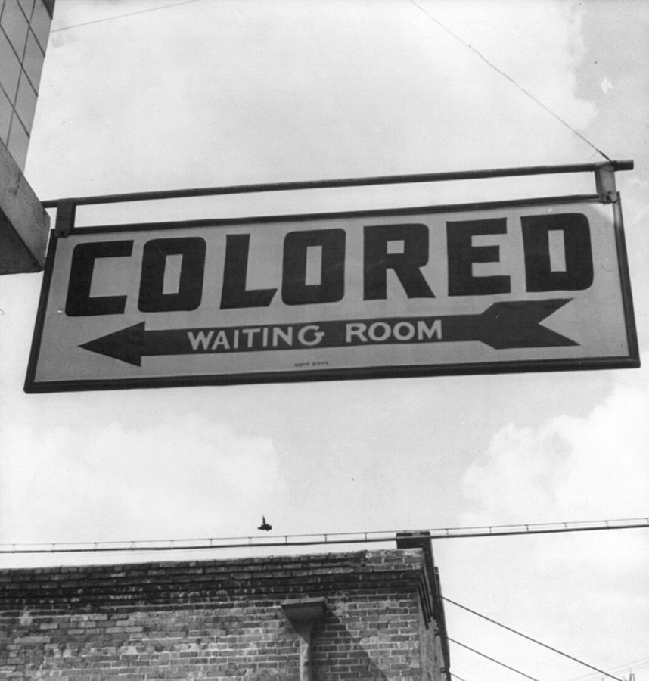
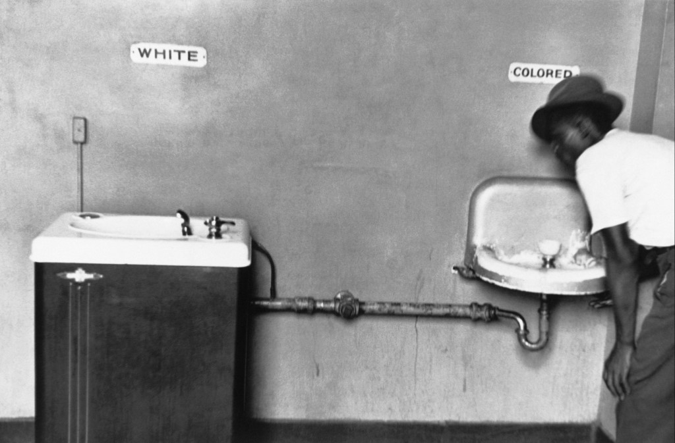
Segregation
Was a legal and public system
Apartheid
Religious Segregation
Notes:
Zahra
Segregation was a legal and public system that separated people by their race, and this is unfair and not equal to anyone. Separate but equal was a legal belief and is how people defined segregation. People thought that it would be best if citizens were sorted by their color. Racial segregation was official in 1865 and ended in the year of 1964. Another term for racial segregation is apartheid.
Apartheid which in the language Afrikaans means Apartness. Apartheid is a form of racial segregation which was put in 1948,which was strictly enforced by the all-white government who used to separate the races, leaving the white race the best they could offer.
Religious segregation also exists, Religious segregation happens when people are separated based off of their religion. Some laws of country's only apply to one religion. An example of that is Sharia which applies to only Muslims. Another example of religious segregation is that in Iran some students were not allowed to enter a school because the school only allowed muslims and the student wasn't a muslim.

Slide 6
Islamic perspective
The Ayahs
Sura Al-Mulk
Everyone should be treated equally
There is no gender, race, or culture superior to the other​
He who created life and death to test you as to which of you is best indeed
In Islam your wealth does not define who you are
Notes:
Zayaan: Islamic Perspective Saira: The ayahs
Islam believes, everyone should be treated equally. Islam believes there is no gender, race or culture most superior then another. We are all equals in Allahs eyes except for the most pious. We should treat others with respect and support and not block them from anything except for commiting unjust. Even though we are all equal, doesn't mean we have to all have equal money, or things. when people do that it is called comunism. Islam does not believe in comunism. Just we are all human being and should be treated good like others.
Allah wants us to treat other nicely and to treat them like a brother/sister. Because all of us humans are descended from Prophet adam (PBUH)Allah says we should not commit comunism ,because he who does it is not a real muslim. The way we act reflects our character. Life is one big test upon your character. If your poor for example but your grateful or patient, Allah will make you rich in jannah, so in Islam the amount of money you have doesn't matter because Allah made you rich or poor to test on how you would react. If you were grateful or patient. In Islam we have the right to be educated and to learn the Quran. In Islam to gain knowledge can mean many things.
. As Prophet Muhmmad (PBUH) said "If someone does good support them, and if they do bad stop them or separate yourself from them." We muslims have a right and responsibilty to pray for other muslims. We must always seek knowledge,because allah said knowledge is light.Allah says for those who seek knowledge,Allah will open the gates to jennah.

Slide 7
Ayah Al-Hajurat
O mankind, indeed We have created you from male and female and made you peoples and tribes that you may know one another. Indeed, the most noble of you in the sight of Allah is the most righteous of you. Indeed, Allah is Knowing and Acquainted.
Notes:
Zayaan

Slide 8
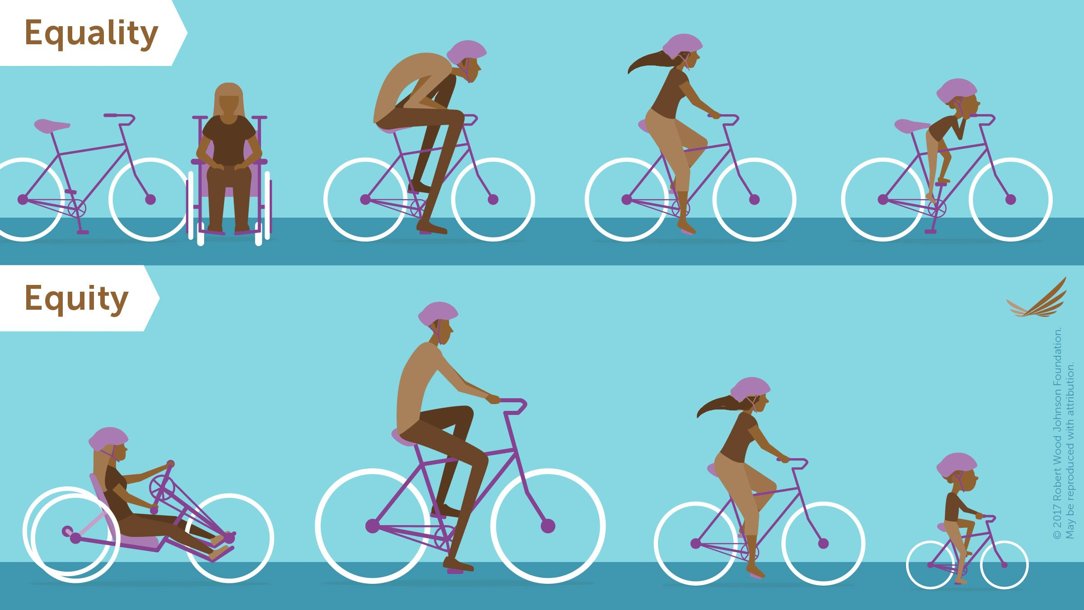
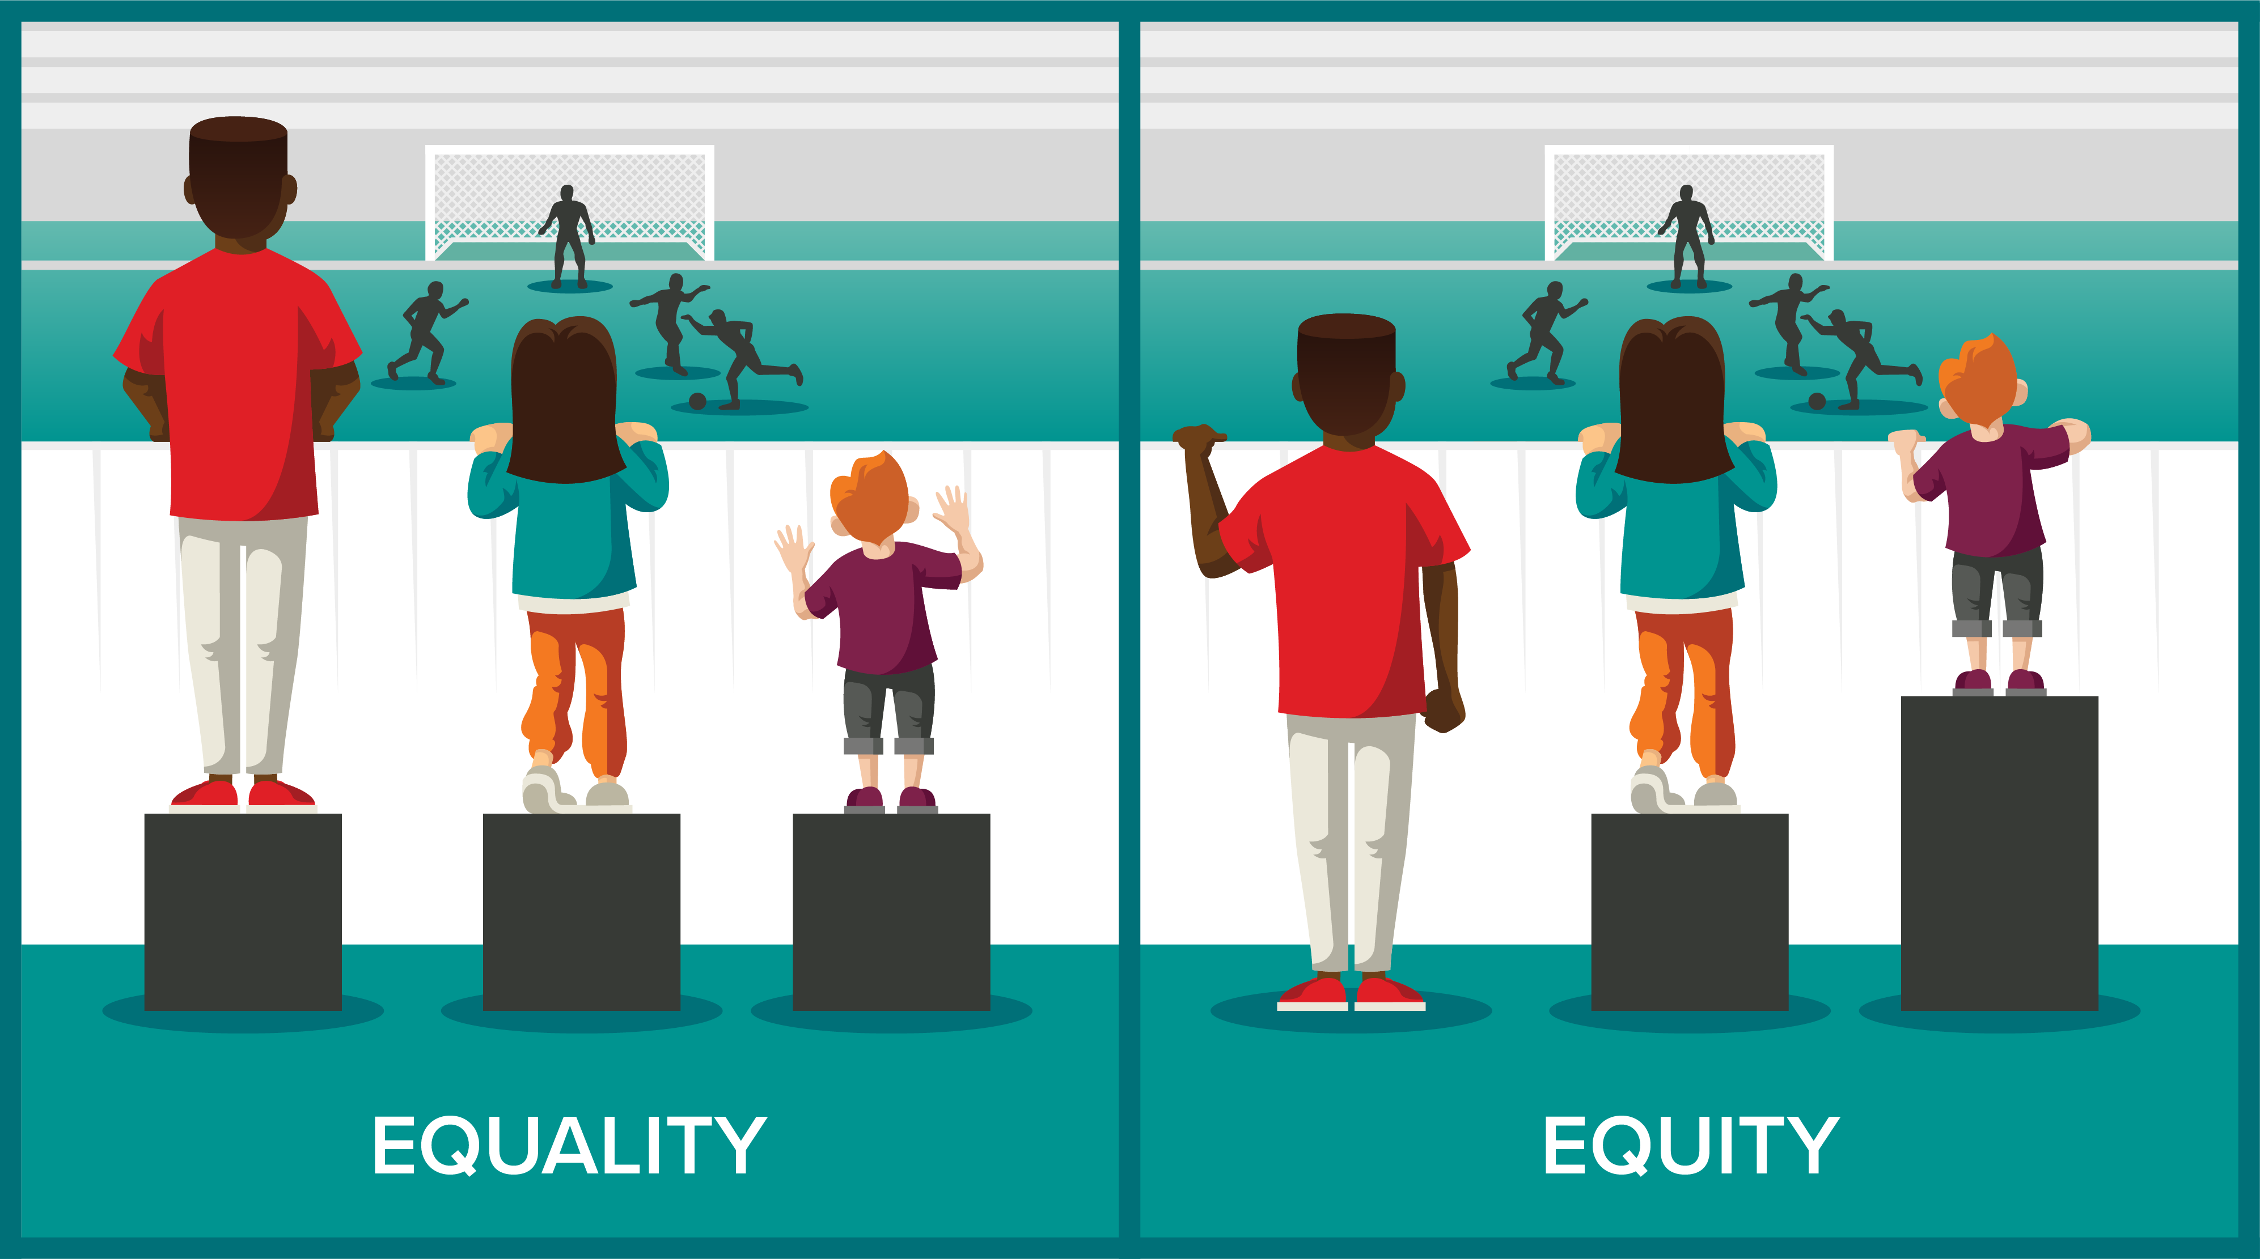
Group Action
Art Contest showing equality and equity!

Slide 9
Sources
Education :
Giftofcollege.com
February
https://www.bbc.com/news/world-asia-india-35650616
Surprising facts about education 50 years ago
Thursday, June 28, 2018
Segregation :
February
Kids.kiddls.co
https://www.giftofcollege.com/blog/2018/6/28/surprising-facts-about-education-50-years-ago/
Religious segregation facts for kids
Kiddle.co
2020
Social Class :
bbc.com/news/world-asia-india
February
https://kids.kiddle.co/Religious_segregation
What is India's Caste System?
BBC
2021
Notes:
Zahra. Thanks to allah, then parents teachers and then others. Education Sources
Social Class Sources:
Segregation Sources:
Quran, Ayahs, Islamics Perspective Sources: Thanks to:
Brother Sami Elzaharna
Imam Muhmmad Abdullahi
Ms. Nahla Aboushaara
Ms. Shabana Ahmed
Ms. Hala Salama
Ms. Mariam Eltoweissy

Slide 10
https://www.publicschoolreview.com/blog/10-major-challenges-facing-public-schools
https://www.enotes.com/homework-help/what-similarities-between-class-caste-system-188583
https://timesofindia.indiatimes.com/india/indian-caste-system-is-very-bad-dalai-lama/articleshow/63782327.cms
https://www.britannica.com/topic/social-class
https://courses.lumenlearning.com/boundless-sociology/chapter/social-mobility/
https://en.wikipedia.org/wiki/Separate_but_equal#:~:text=Separate%20but%20equal%20was%20a,the%20law%20to%20all%20people.
https://www.scencyclopedia.org/sce/entries/segregation/
https://en.wikipedia.org/wiki/Racial_segregation
Brother Sami Elzaharna ​​
​​
Imam Muhmmad Abdullahi ​​
​​
Ms. Nahla Aboushaara ​​
​​
Ms. Shabana Ahmed ​​
​​
Ms. Hala Salama ​
​
Ms. Fatima Khan​​
​​
Ms. Mariam Eltoweissy

